Slide 1




Welcome to
CSA2002 INTRODUCTION TO DRONES
G.GANESAN, B.E (CSE)., M.E (CSE)., M.S(IT).,MISTE.,
SENIOR TEACHING FELLOW,
SCHOOL OF CSE.
+91-9500234437
ganesan.g@vitbhopal.ac.in

Slide 2
Course Content
Date: 23-01-2023 Time: 10.05am – 11.35am
How to differentiate Multirotor Drones.
Drone Frames
3. Motors
4. Battery
5. Connectors

Slide 3
Multirotor Drones
1. Single Propeller Drones
- Up and Down, Rotating in a single point (Newton’s Third Law)
2. Two Propeller Drones
- Long Life, Opposite Side Rotation, Good Stability
3. Three Propeller Drones
- Better Positioning, Avoiding algorithm complications.
4. Quadcopter
- 8 and X shapes, Force Dynamic Algorithm ensure Weight and
Thrust.
Pitch Motion - To move front - Front slow down and Rear speed up
Yaw Motion – Slow down one – spin it.

Slide 4
Multirotor Drones contd…
Flight Controller – If any wind trouble – manual control in a second is
not possible most of the time
- Main Sensors (IMU) – Accelerometer, Gyroscpic, Magnetometer
- GPS - If any magnetic interference
– Use Sensor Fusion Technique – Provide altitude with IMU &
also Radar that makes the Decision.
- Kalman Filter – Read past and present data to know the state of the
drone – controlling speed, Stabilize the drone if a
disaster wind / back to home. (DJI)
How to bring the drone home if it is in out of the control signal range?

Slide 5
Multirotor Drones contd…

Slide 6
Unstructured Drones
Gliding or Fixed Wings Drones.
- Look like airplane, Shapes and Sizes are vary.
1. Ready to Fly (RTF) – No assembly required, No complex setup or
programming knowledge.
2. Bind N Fly (BNF) – Transmitter should be bind with by ourself.
3. Almost Ready to Fly (ARF)
– User must assemble the parts using user manual.

Slide 7
MOTORS

Slide 8
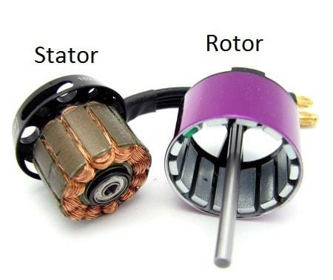
Basics of a Motor
Two major parts of Motor – Stator and Rotor.
Stator – Stationary part of the motor (Windings)
Rotor – Rotatory part of the motor (bell with magnets).
Also there are a lot of minor things – Bearings, Coils, Magnets, Shafts etc.
A motor size is based on the stator size (diameter and height).
Ex: If a motor size is 2207 – stator width is 22mm and height is 07mm.

Slide 9
Thrust to Weight Ratio
General rule of thump is 2:1 thrust to weight ratio.
Thrust to weight ratio depends mostly on the size of the quads.
- Diatone Crusader GT – 8:1
Photography – 3 or 4:1 (can upgrade by HD camera or Big battery)
Racing beginner – 4 or 5:1 thrust is best.
A motor indicated by a set of 4 numbers like 2207 or 2306, etc.
- 2207 – rotor diameter is 22mm and height is 07mm
Bigger motor gets the higher the thrust it generates.

Slide 10
Thrust to Weight Ratio
Taller Stator = higher top speed and terrible low speed handling.
Wider Stator = lower top speed and better handling at lower speeds.
The taller stator have larger magnets than smaller and wider.

Slide 11
Selection of Motor
Selection of motor depends upon the drone size.
Frame Size = Motor size.
Frame size also limits the prop size.
Each propeller requires a different motor to spin it and generate the
thrust efficiently.
KV also plays major role in the selection of motor.

Slide 12
Motor Types for Drone to Fly
Brushed
Brushless
Internal working principles are same – based on Electromagnetism.
When the motor windings become energized (both have coils),
a temporary magnetic field is created that repels against the
permanent magnets present inside the motor.
This magnetic force is creating the repulsive force in the coil that is
used to spin/rotate the shaft.

Slide 13
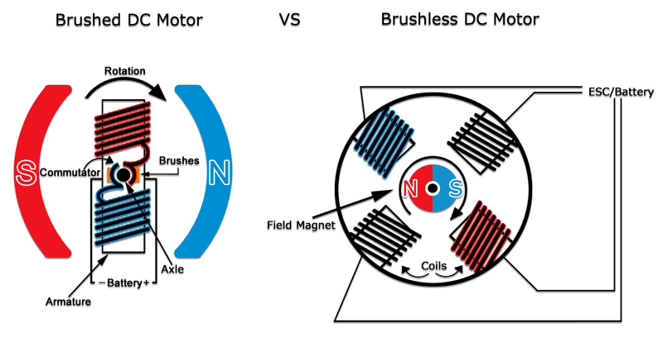
Motor Types for Drone to Fly contd…
What you mean DC Motor?

Slide 14
Motor Types for Drone to Fly contd…
Efficiency wise, brushed motor is 75-80% efficient whereas a brushed motor is 85-90% efficient.
The efficient of a motor is, the total power being turned into
“rotational force” and less power lost as “heat”.

Slide 15
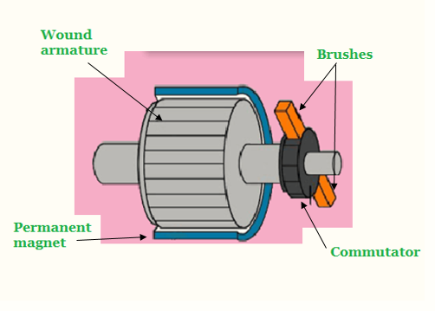
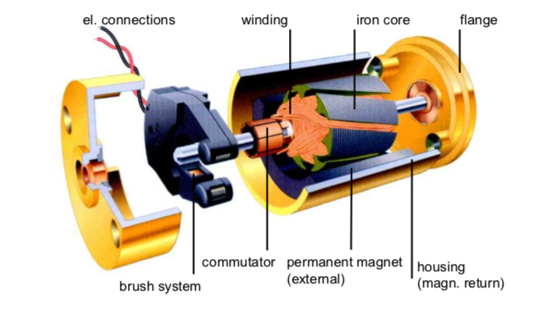
Brushed Motor
Brushes used to deliver current to the motor windings through
mechanical commutation.
The number of coils wound around the motor and the density of the
coils determine the properties of the motor.
Pair of permanent magnets – stator and rotor (motor coil)

Slide 16
Brushed Motor
Conductor always locates on the turning part and get DC power.
It uses metallic brushes (rotate along with the rotor) to transfer the
current to the coil.
Require periodic maintenance of brushes.
Brushes transfer current to the armature through physical contact
with the commutator.
Repelling the poles in stator – the motor shaft where the armature coil attached begins to rotate with a speed and torque.
The speed and torque depends on the strength of the magnetic field
around the armature.

Slide 17
Brushed Motor
Conductor always locates on the turning part and get DC power.
It uses metallic brushes (rotate along with the rotor) to transfer the
current to the coil.
Require periodic maintenance of brushes.
Brushes transfer current to the armature through physical contact
with the commutator.
Repelling the poles in stator – the motor shaft where the armature coil attached begins to rotate with a speed and torque.
The speed and torque depends on the strength of the magnetic field
around the armature.

Slide 18
Brushed Motor - Advantages
Low overall construction costs
Rebuilt to extend life
Simple and inexpensive controller
In fixed speed, no need of controller
Ideal for extreme operating environment

Slide 19
Brushed Motor - Limitations
1. Less efficiency
2. Electrically Noisy – Switching action of the commutators
constantly creating and breaking inductive
circuits creates electrical and electromagnetic
noises.
3. Lifespan – Physical contact with the shaft, brushes and
commutators wear out.

Slide 20
BRUSHLESS MOTOR

Slide 21
Brushless Motor Size Chart
Table: Nominal Frames and Quadcopter Motor Numbers
Frame Size | Propeller Size | Motor Size | KV
15mm and smaller | 3” and smaller | 1105-1306 | 3000 and higher
180mm | 4” | 1806 | 2600-3000
210mm | 5” | 2204-2208/2306 | 2600-3000
250mm | 6” | 2205-2208/2306 | 2000-2300
300mm | 7” | 2208/2212 | 1600

Slide 22
Performance Factors - KV
KV rating – Speed at which the motor rotates for every volt.
Ex: If a motor is 2300kv with 3S quadcopter battery motor. The motor will spin at 2600 x 12.60 = 32,760 rpm without propellers.
The rpm decreases gradually by air resistance.

Slide 23
Performance Factors
Kv
Torque (Spinning Force)
Efficiency
Temperature
N (poles) and P (magnets)
Wires
Magnets

Slide 24
Performance Factors - KV
Higher the KV : Lower resistance and higher current draw and lower
efficiencies.
Lower the KV: Higher resistance and lower current draw and better
efficiencies.
Ex: If a motor is rated at 2300kv with 3s battery voltage applied to it,
then the motor will spin at 2300 X 12.60 = 28,980 rpm without propellers.
This is the maximum rpm at no load.

Slide 25
Performance Factors - KV
Higher the KV : Lower resistance and higher current draw and lower
efficiencies.
Lower the KV: Higher resistance and lower current draw and better
efficiencies.
Ex: If a motor is rated at 2300kv with 3s battery voltage applied to it,
then the motor will spin at 2300 X 12.60 = 28,980 rpm without propellers.
This is the maximum rpm at no load.

Slide 26
Performance Factors - Torque
Torque is the spinning force or the rotatory force that spins the
propeller.
Torque affected by
Stator Size – Bigger the stator higher the torque
Materials – Magnets and Copper windings
Motor construction – Air gaps between stator and rotor.
The major disadvantage of high torque motors are bad oscillation.

Slide 27
Performance Factors - Efficiency
Dividing the Thrust produced by the motor at 100% throttle by the
Power produced by the motor.
Efficiency = Thrust / Power g/w (grams per watt)
Note: All the time flying 100% throttle is not possible. (0% to 100%)

Slide 28
Performance Factors - Temperature
Temperature or heat is a killer.
- Losing magnetic field strength
- Demagnetize over time when constant heat.
Resulting to reduce lifespan of the motor.
Reasons: Using higher throttles for long periods of time.
Design: Cooling fins – suck in air into the motor

Slide 29
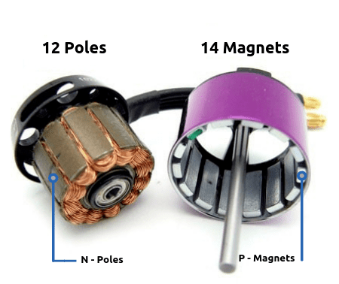
Performance Factors – N and P
The 22xx or 23xx motor will have 12 Poles and 14 Magnets.

Slide 30
Performance Factors – Wires
1. Single Stranded Wires: Thicker and handle heat produced,
Better on high voltage builds.
2. Multi Stranded Wires: 3 smaller wires – Break or Melt easily at high
temperature.
Gives strong magnetic fields by tighter and
close together the wires.

Slide 31
Performance Factors – Magnets
Weaker magnet produce less thrust.
Higher end motors have Curved Magnets.
Other factors are:
Motor windings – Copper quality
Motor weight – 5” quad weight with wires 30-40 grams.
- 2306 – 25 grams, 2204 – 34 grams
Motor Mounting Patterns – All motors either (16x16) mm or
(16x19) mm mounting patterns.

Slide 32
Performance Factors – Feature
Motor Shaft – Hollow shafts instead Solid shafts – reduce weight.
Air Gap – Closer the rotor to stator (Magnets to the windings) the more efficient it is in converting the current. Smaller air gap the
higher thrust.
3. Motor Wires – 20 Awg or 18 Awg (American wire gauge)
- Emax RS series 20 instead 22 increase 5% output.
4. Retainer Clips – 3 types – E, C, Screw retainers.
E clip hard to remove and Screw retainers are easy but unscrew
or loosening under constant vibration.

Slide 33
Comparison
 | Brushed Motor | Brushless Motor
Life time | Short (Brushes wear out) | Long (No Brushes to wear)
Speed and Acceleration | Medium | High
Efficiency | Medium | High
Electrical Noise | Noisy (Bush arcing) | Quiet
Acoustic Noise & Torque Ripple | Poor | Medium (trapezoidal) or good (sine)
Cost | Lowest | Medium

Slide 34
Battery
Hydrogen Fuel Cells
Lithium Iron
Lithium Polymer
Nickel Metal Hydride
The most usage of batteries are Lithium Iron and Polymer.

Slide 35
Battery
Hydrogen Fuel Cells
- Technology – Electrochemical reactions
- Power Path Module (PPM) – Single / Dual regulator.
- Zero emissions, Qick to refuel or swap out, 2.4kW.
- Integrated with variety of multi-rotor and fixed-wing
UAV platforms.

Slide 36
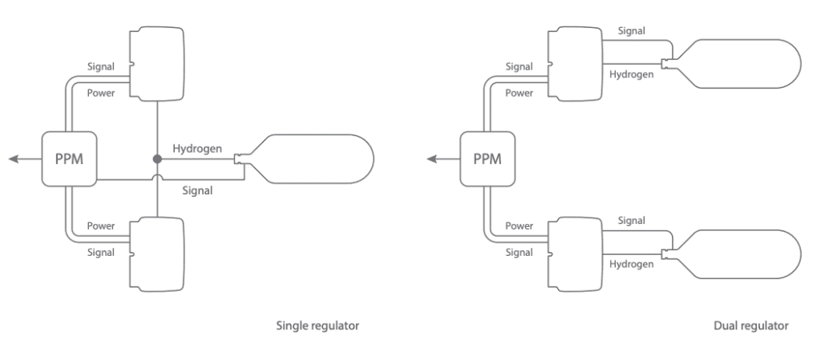

Slide 37
Lithium Iron
Cost-Effective – Less, Longtime, transportable
High Power Density
Easy Maintenance
Continuous Voltage – steady voltage
Variety of Models

Slide 38
Lithium Polymer
Cost-Effective – Less, Longtime, transportable
High Power Density
Easy Maintenance
Continuous Voltage – steady voltage
Variety of Models

Slide 39
Nickel Metal Hydride
Rechargeable
Recycling profitable
Non toxic
Wide temperature range

Slide 40
Battery - Choosing
Size and Weight
Cell Count / Capacity
Voltage
Discharge
Connectors

Slide 41
Battery – Current Output
If the current is I, battery capacity is C, and discharge rate is D, then
Instantaneous Current drawn I = CxD
If a battery have 3 cells and each has 5,000mAh and the discharge rate is 10C
The current drawn I = 5.0 x 10 = 50A (1 Ah = 1000 mAh)

Slide 42
Battery – Maintenance
1. Charging: Lithium batteries are normally charged at 1C.
1C x 3700mAh = 3700mA or 3.7 A
2. Balance Charge: Monitor each cell charged the same voltage.
3. Direct Charge: Fastest way to charge, unbalanced charges in cells.
4. Discharge: Determining the full capacity of a battery.
5. Storage: Each cell is ~3.8v or the recommended one.

Slide 43
Connectors
Connectors are most important things for the power and other parts.

Slide 44
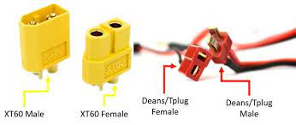
Connectors

Slide 45
Thank You
&
Queries?

